Slide 1
Perspectives from voluntary sector practitioners responding to sibling harmful sexual behaviours, and specific considerations when working with Black, Asian and minority ethnic children and families
Michelle West, NSPCC
Spencer Bailey, Barnardo’s
Ray Tait, Independent

Slide 2
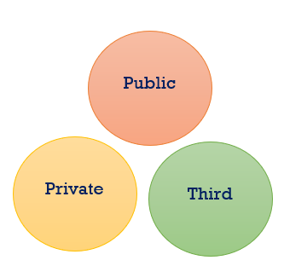
Overview
The role and historical context of charities
Current charity sector provision – HSB services
Strengths and limitations of voluntary service provision working with children and families in response to SSA
Specific considerations working with Black, Asian, and minority ethnic (BAME) children and families
Best practice considerations
Future directions
Notes:
Michelle
Charities a ‘catch-all’ term
Variety of terms used. Third sector, voluntary sector. not-for-profit’ and is not government controlled.
US – known as third sector, UK – voluntary sector. Terms now merging, third sector commonplace and encompasses voluntary and community organisations, charities, social enterprises, cooperatives and mutuals. Some argue not a coherent sector.
Presentation specific to charities working with SSA .
Traditionally, it has occupied a ‘third space’ and sits between the public and private sectors – boundaries less distinct gov. funding of charities.

Slide 3
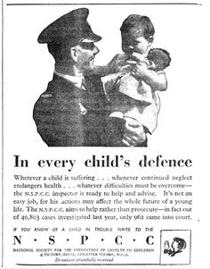
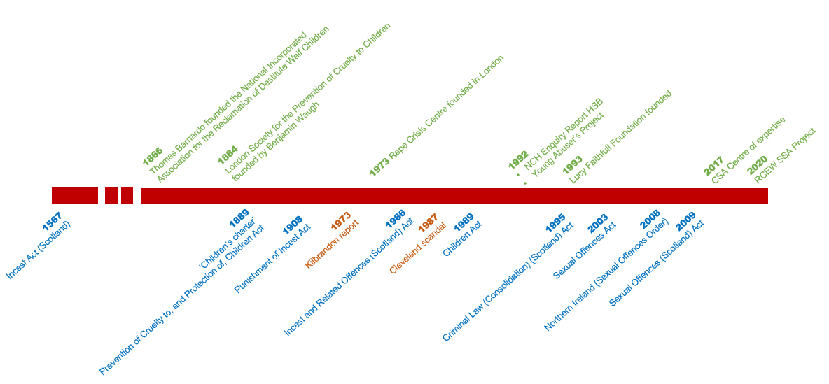
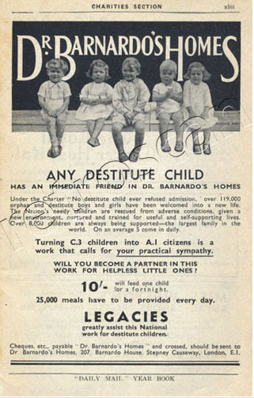
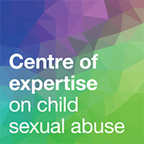
A (very) partial history
Notes:
Incest previously a religious offence
Scotland – C16th law of incest was based on the Incest Act 1567 which incorporated into Scots criminal law chapter 18 of the Book of Leviticus Book of Leviticus – The Lord spoke unto Moses saying…”Thou shalt not discover the shame of thy [e]sister…whether she be born at home or born without”
London SPCC, later NSPCC campaigning led to the Prevention of Cruelty to, and Protection of, Children Act 1889
First act of parliament for the prevention of cruelty to children, commonly known as the ‘children's charter’ was passed. Enabled the state to intervene, for the first time, in relations between parents and children. Police could arrest anyone found ill-treating a child, and enter a home if a child was thought to be in danger
All cases of cruelty to children reported to the Met and City of London Police handled by NSPCC
Retain statutory powers in Children Act 1989
NSPCC authorised persons status s.31 CA89 and s.49 Children (Northern Ireland) Order 1995
1908: Punishment of Incest Act (E&W) made sexual abuse within families a matter for state jurisdiction rather than intervention by the clergy.
Incest specifically intercourse rather than other forms of sexual behaviour; it is heterosexual and defined by the relationship which already exists between offender and victim.
Some overlap between incest and CSA
Brother-sister incest recognised and reported in early studies (Gibbens et al., 1978 – around 1/5th of incest offences in 1961 (charged and guilty) brother-sister
Incest Act (Scotland) 1567 updated 1986 and consolidated 1995. - main piece of legislation which regulates the law of incest in Scotland.
Rape Crisis movement – increased recognition of incest, influence on changes in law e.g. rape in marriage has been recognised in law in the UK, and oral and anal penetration have been included in the definition of rape
Cleveland scandal – moral panic collapse of family – shone light on familial CSA, health led CSA no longer stranger danger and involved middle class families
Monumental report NCH Enquiry HSB shone light on extent of sexual abuse by other C&YP and need for assessment and treatment provisions.
Recognition of role and importance of voluntary services in HSB provision with Committee recommending DoH and Home Office as brokers of services provided by LA, Health, and voluntary sector.
1992 Young Abuser’s Project Eileen Vizard – continues today as NCATS joint NSPCC & health
Sexual Offences Act 2003 – incest removed from law, definition broadened replaced with familial child sex offences or sex with adult relative.
Northern Ireland (Sexual Offences Order, 2008): Sexual activity with a child family member (art. 32)
Sexual offences against children committed by children or young persons (art. 20)

Slide 4
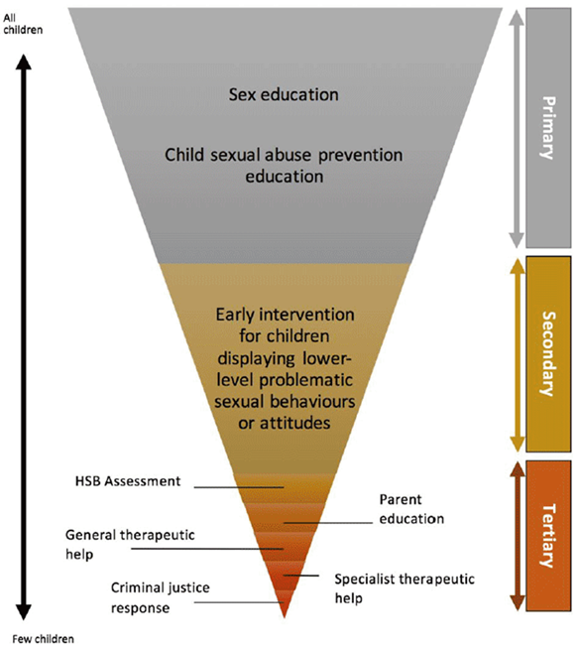
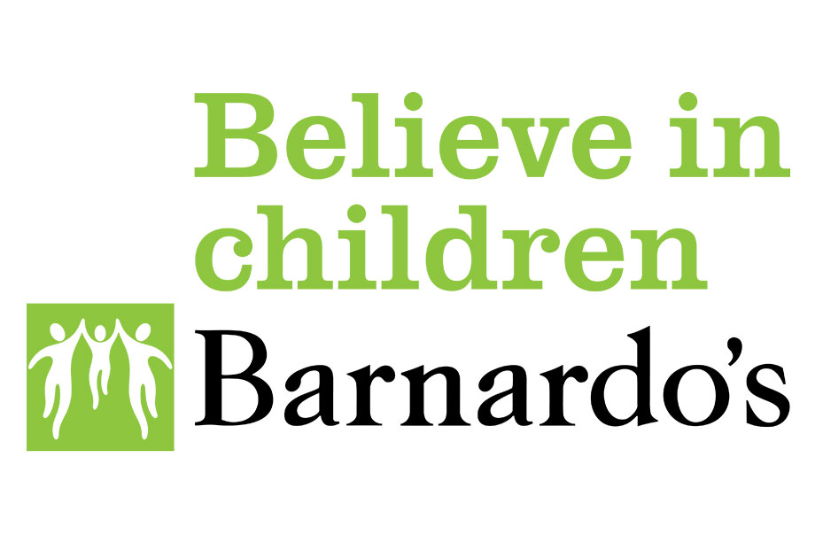
Charity sector HSB service provision in the UK today
Hackett, (2020), cited in Scottish Government p. 55
Notes:
HSB focus, Support for victims of SSA = Rape Crisis England & Wales and Rape Crisis Scotland, and also NI – some HSB services children
Glebe House, Friends Therapeutic Community Trust, Quakers. Not-for-profit (e.g G-MAP), and private sector (e.g. community - Polaris, SWAAY, residential - Woodlands) HSB provision acknowledged but not part of this discussion.
Voluntary sector organisations across the UK provide primary, secondary and tertiary services to prevent all HSB. Mostly tertiary, a lot less primary

Slide 5
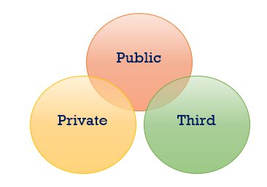
Charity sector responses to SSA – strengths
Flexible approaches and partnership
Income and funding
Non-statutory role, independence (Strategy Unit, 2002)
Specialism, niche provision (Bolton, 2003)
Intervention-focused
Reputation, trust, intrinsic values (Anheier & Kendall 2002)
Advocates of change (Knight & Robson, 2007)
Notes:
Distinct social value
The Forms of Capital, Pierre Bourdieu distinguishes between three forms of capital: economic capital, cultural capital and social capital
Approaches – whole family work (importance in HSB, specifically SSA, partnership e.g. B’s joint work model with YOT, NCATS and Together for Childhood in Plymouth (CSA prevention). Hybridisation – increasingly charities delivering state-funded services. Fill gaps in provision (otherwise unmet)/innovative service development and approaches. (See Venn diagram)
Income – grants, additional funding e.g. Junction
Non-statutory/independence – Distinct from market and state. ‘Government recognises that the key to the sector’s success is its independence from Government.’
Non-statutory role in SSA, more balancing relationship with families importance for therapeutic work
Specialism – rather than generic teams, focus on specialist area of HSB . Importance in this complex and challenging area of work. Perhaps impossible to achieve in generic role. Vol. orgs. ‘are good at meeting special needs or responding to niche areas of provision because they have significant expertise’ and ‘are an independent voice (Bolton, 2003)
can provide innovative services to people with specialist or more complex needs that other sectors are unable to meet (Bolton, 2003)
Intervention focused – without statutory role more opportunities and time for direct work. But…importance of assessment AJ
Reputation and trust - Hansmann (1980) more trusted than other types of organisations, especially provider-user power imbalances
Advocates of change – SSA in multi-agency meetings (e.g. specialist knowledge, not influenced by LA resource considerations, e.g. AJ). Wider: influences public policy and services, campaigns/awareness of emerging issues.
Multi-disciplinary – e.g. NCATS health, systemic psychotherapy. Barnardos’

Slide 6
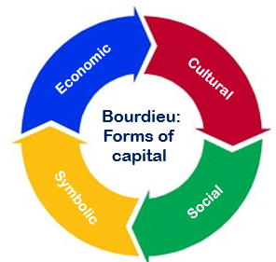
Charity sector responses to SSA – strengths
Economic capital: income and resources
Cultural (organisational) capital: values, beliefs, relationships
Social capital: connection, information, networks
Symbolic capital: status, legitimacy, influence
Notes:
Summary in terms of capital Bourdieu
Capital not just money. The Forms of Capital, Pierre Bourdieu distinguishes between three forms of capital: economic capital, cultural capital and social capital. The more capital, the more powerful.

Slide 7
Charity sector responses to SSA – limitations
Status
Funding uncertainty
Precarious sector (Power et al., 2021)
Short-term or partial funding
Planning and sustainability
Capacity limitations
Contracted services – tensions and compromises (Kendall, 2003; Smerdon, 2009)
Distinct and different – contested claim (Macmillan, 2013)
Heterogeneity of services – structure, funding, provision
Notes:
Spencer
Status (cf. CP social work, less influence and whilst can advise and recommend, decisions made by statutory sector, sometimes at odds)
Funding – some precarity as a hallmark of third sector, exacerbated by austerity
Funding can be uncertain – impacts on job security and resultant impact on children and families.
Sources of funding on prevailing issues e.g. CCE/CSE high agenda
Longer-term planning and service design difficulties
Limits to how many children can work with – capacity determined by contracts and difficult to change at short notice demand
Contracting of services from government funding argued limits independence – agents of the state
Strengths of charity services described by and practitioners have been contested by some research
Diverse sector – even within one charity, HSB services in one part of the country may be funded and structured differently to those elsewhere. Makes it difficult to generalise what a typical charity sector HSB servicer looks like.
We’ve briefly seen what charity sector responses to SSA may look like, and now specific considerations working with for Black, Asian minority ethnic children and families, firstly looking at what we know about ethnicity SSA prevalence studies

Slide 8
SSA prevalence – ethnicity
Variations in research designs provide different estimates of CSA prevalence
British HSB services
(Hackett et al., 2013):
93% white
1% Black
3% Asian
3% Mixed race
Children from Black, Asian and minority ethnic backgrounds are under represented in Social Care services generally and specific services relating to Child Sexual Abuse
Official data often do not detail specific ethnicities, religion or relationships
True extent of CSA unknown, available information does not include to sibling Sexual Abuse and ethnicity
“It is extremely difficult to establish with any reliability the prevalence and extent of child sexual abuse generally, given its hidden nature, the stigma it carries, and the lack of disclosure due to the silencing of victims”
(Kelly & Karsna, 2018)
Notes:
Michelle
We know that children from Asian, Black families are under presented within children accessing social care in terms of Child In Need and Child protection. There are higher numbers of mixed heritage children,
Data is collected from Police, social care, health and education – They collect different information, and this can be difficult to draw any conclusions.
When we were researching this presentation we found that in Serious Case reviews relating to HSB Ethnicity was often unknown, or not considered to be of any significance.
There is very little academic research into sibling sexual abuse generally
Even less into Black, Asian and minority ethnic groups
What research is available explores Child Sexual Abuse generally – this often includes adult survivor accounts
Data is not collected from Police, Social Care and Health on Sibling Sexual Abuse
In 2021 Children in Need data included sexual abuse by a Child towards a Child for the first time

Slide 9
Case study – ‘Nice’ family
AJ – 14 Years old. Non-white, English not first language, seeking asylum
Allegation – sexual touching of 9 year old sibling under clothing
Children’s Social Care – accommodated (s.20) into foster care and CP Plan sibling
Referred to HSB charity service – assessment and intervention support
Aims and outcomes of the HSB support – undertake an specialist assessment of AJ and family, support with safety planning, inform Child Protection planning and reunification decisions
AJ and Mum are apprehensive about the support and no specific support for siblings or Mum
Notes:
Composite case study. Different aspects of several cases referred to NSPCC and Barnardo’s. Anonymised, no identifying information

Slide 10
Case study – internal barriers to disclosure and support
The sibling told a teacher and was afraid to tell their mother
Comments by the family about AJ bringing shame onto the family
Curious – Empathic- Culturally competent
Fear of being punished/rejected
Fear of being disbelieved or ignored.
AJ’s reluctance to speak about family life
‘Silence’
Pressure within families and communities to maintain honour and prevent shame.
Pressure to conform to and cultural norms around
gendered roles
Purity for girls and women and masculinity for boys and men
Mother hadn’t considered SSA
Thought they just were being curious
Mother is afraid of anyone else finding out in community
Lack of understanding and awareness of concepts such as CSA
Notes:
Ray

Slide 11
Case study – external barriers
Poverty
Poor Housing
Poor Health
Access to resources
(Telephone, Internet, Travel)
Cultural competency
Lack of cultural understanding in statutory agencies and service providers
Immigration status
Stigma and shame of insecure asylum status
Communication
Written and spoken barriers
Failure by support services to recognise and take account of cultural issues and experiences
Distrust of services, limited awareness of services
A lack of culturally specific voluntary sector provision
(Atkin & Rollings, 1993)
Racism and Unconscious Bias within services about communities and within communities about services
Notes:
Ray
Impact of Use of Pornography There is growing concern that viewing adult pornography can have an impact on young people’s sexual behaviour, especially young people under the age of 1377 . Exposure to pornography is increasingly being identified as a contributory factor in the emergence of HSB78. This resonates with wider concerns around the extent to which children have access, or are exposed, to online sexual and or violent material79 .
Evidence suggests that children and young people who are educated about online pornography during sex education classes are less likely to be negatively influenced by online pornography than those who have had no lesson on the topic.
Hollis and Belton, 2017, HALT, 2019 Reluctance to challenge attitudes and practices.

Slide 12
Unconscious bias
Negative impact on responses to CSA:
Adultification bias (Blake & Epstein, 2019; Davis & Marsh, 2020)
Overlooking child protection concerns, dismissing as ‘culture’ (Rodger et al., 2020)
Fears about stereotyping, racism, insensitivity (Henderson et al.,2017)
Impact of unconscious bias on children, families, and communities:
Unhelpful cultural stereotypes – missed opportunities to identify and respond to CSA
Impact on disclosure
Disproportionate representation in youth justice system (Ministry of Justice, 2021)
School exclusions and long-term outcomes (DfE, 2020; Sullivan, 2018)
Notes:
Michelle
Unconscious bias – can negatively impact how adults respond to child abuse (IICSA, 2020)
Adultification bias which perceives children as being streetwise, grown up and less vulnerable than other children. Children can be viewed as a threat than needing support (Davis and Marsh, 2020; Georgetown Law Centre on Poverty and Inequality, 2019)
Overlooking child protection concerns about Black, Asian and Minoritised ethinc communities, or not taking them as seriously as they would for children from other communities. Dismissing behaviours or practices as ‘culture’ and not taking protective action (IICSA, 2020)
Worrying about being perceived to be racist or insensitive if concerns are raised. Fears about stereotyping, can lead to attempts to not acknowledge another person’s race or ethnicity. Resulting in a ‘universal’ approach being applied to all families that fails to understand parenting practices and beliefs within the family and culture (SCRA,2017)
The impact of unconscious bias on children, families and communities
Unhelpful cultural stereotypes, unconscious bias and racism can lead to missed opportunities to identify and respond appropriately to child sexual abuse. They also make it more difficult for individuals in ethnic minority communities to disclose and speak up about child sexual abuse
Black and dual heritage/mixed-race children are disproportionately represented within the youth justice system (Ministry of Justice and Youth Justice Board for England and Wales, 2021).
There are higher than average rates of exclusion amongst Children from Black Caribbean, Gypsy, Traveller and Roma communities. With lower than average rates amongst other communities. Exclusion from school can lead to long – term negative outcomes (SecEd, 2018, Department for Education (DfE), 2020).
Unconcious bias –
Unconscious bias might take the form of:
racist stereotypes
confirmation bias (seeking or favouring information that confirms your existing beliefs)
judging people according to first impressions.
For example, practitioners may sometimes have preconceived concerns about whether a child’s parents or carers are legal immigrants (IICSA, 2020). By focusing on the parents’ residency rather than their child’s welfare, practitioners might not consider the lived experience of that child and miss indicators of abuse.
Unconscious bias examples – interpreting behaviour differently depending on ethnicity, examples – if Black or Asian and other minoritiesed communities show fear around family members, this maybe interpreted as a sign of repect and not an indicator of abuse (SCRA, 2017)
Criminal justice system
There are many complex reasons for this disparity between groups of children (Lammy Review, 2017). One reason might be that Black and mixed-race children are sometimes adultified and held to a more mature standard of behaviour than their peers. This might lead to children receiving a criminal justice response from the adults around them, rather than a child protection response (Davis and Marsh, 2020).
Different types of abuse maybe connected with specific groups – black children are more street wise, premesquiecs, South Asian males target only white females for sexual abuse.
Leading to accounts of abuse being missed or discredited, if they don’t fit the stereotype held by the practitioners
Adultifiation –
Children who have been adultified might also be perceived as having more understanding of their actions and the consequences of their actions. For example, an analysis of case reviews found that practitioners assumed Black boys who were involved in gangs would be able to protect themselves from harm, even after they had been reported missing from home or care. This resulted in the practitioners not acting to protect the boys from sexual exploitation, youth violence and drug and alcohol misuse (Bernard and Harris, 2019).

Slide 13
Vulnerability factors for HSB
Trauma
Disability (Learning, Physical Social)
Bereavement
Adolescents (Puberty)
Experiencing child abuse
Having a parent with Mental health and/or substance misuse issues
Racism
Social Isolation and poor social skills
Pro –Criminal peers
Mental illness: Depression, Anxiety, OCD and ADHD
Excessive use of Pornography
Gender norms around masculinity and women and girls rights
Bullying
By working with the whole family and understanding the roles within the family, their culture and community you better understand the child that has harmed.
AJ
Notes:
Ray
Physical abuse history - There had been complaints made by AJ and a sibling of physical abuse within the home. Social Care decided there was no evidence and AJ was not believed
AJ was diagnosed with Autistic Spectrum Disorder . This diagnosis was not been accepted by Health Services in the UK, the family had limited documentation and what they was not compatible with the UK requirements .
AJ Witnessed violence and death as a young child.
The outcome of a Trauma Symptom Checklist For Children Analysis identified that AJ was showing signs of Post Traumatic Stress Disorder.
Exposure and excessive use of Pornography – AJ began accessing Pornography daily from the age of 10 years, whilst legal it included sex with family members (step siblings).
Exposure and excessive use of Pornography – AJ began accessing Pornography daily from the age of 10 years, whilst legal it included sex with family members (step siblings).

Slide 14
What we have learnt from practice with young people like AJ?
Understanding the whole family is important, their roles, values and expectations
Working with interpreters is essential
Unresolved or unknown trauma
Cultural barriers and norms – relationships, masculinity, purity
Racism and aggravating factors
Professional responses and influence of unconscious bias
Shame, stigma and family honour
Accessibility – prior experiences of services
Notes:
Ray
- While shame and stigma surround child sexual abuse across all communities, participants identified this as a specific factor influencing how child sexual abuse is responded to within ethnic minority communities. Participants from a range of ethnic groups described how shame and stigma associated with child sexual abuse contribute to a code of silence on child sexual abuse within their communities. Shame and stigma can act as drivers of responses to child sexual abuse that seek to preserve honour rather than to meet the needs of the victim and survivor
Understanding the whole family is important, their roles, values and expectations
Working with interpreters is essential – good practice to identify language barriers at the start and have a plan to work around these, keep the same interpreter that the child and family are comfortable with, interpreters can be a great source of support and information, they can also bring additional challenges
Young people and their families have not been offered or referred to services to support them with past trauma and/or mental health problems. This can be compounded by their diagnosis received in the Middle East or African country not being accepted in the UK. Unresolved / unknown past trauma
Cultural barriers and norms – relationships, masculinity, purity (delete below) to forming appropriate intermate relationships with others: dating is forbidden, lacking in social skills and confidence needed to find a partner, questioning their sexuality and other reasons linked to racism, class and caste.
young people maybe responding to stereotypes and perceived culture norms around masculinity and purity to inform how they should behaviour towards females or be treated by males
Racism and aggravating factors
When anti social behaviour including racism is experienced within their communities a lack of affordable and suitable private or social housing can prevent families from being able to find safety
Experiences of racial bullying are not believed or not taken seriously by parents, teachers and others
Professiuonal responses and infleubce of unconscious bias The responses of professionals can vary from very punitive and risk adverse to minimising and unconcerned based on stereotypes and unconscious bias
Shame, stigma and family honour can lead to a code of silence about child sexual abuse, Shame and stigma can act as drivers of responses to child sexual abuse that seek to preserve honour rather than to meet the needs of the victim and survivor.
Accessibility – prior experiences of services if an agency or organisation isn’t culturally diverse, this may be off-putting to people from Black, Asian and minoritised ethnic communities (IICSA, 2020) Children and adults from Black, Asian and minoritised ethnic communities may not have had positive experiences with ‘official’ agencies in the past. This can change their perceptions of whether practitioners can help and support them, and cause them to be suspicious or fearful of future interactions.

Slide 15
Specific practice considerations - SSA
Importance of professional curiosity and challenge assumptions
Over-reliance on parents to protect all siblings – overload
Needs of children overlooked by need of parents – balance
Concern about a child’s risk to others overshadows the risks they are exposed to – not appropriately protected
Notes:
Michelle
Cultural competence means being able to work effectively with people from different backgrounds, valuing diversity, being aware of personal assumptions and biases and thinking about how to overcome barriers (Larson and Bradshaw, 2017). Rather than focusing on someone’s knowledge of a specific culture, cultural competency highlights interpersonal skills such as openness, respect and willingness to learn

Slide 16
Learning for practitioners – cultural competence
Keep an open and inquisitive mind, avoid comparisons
Non-judgemental knowledge of community’s dynamics, including:
Acknowledging and challenging any preconceptions about community
Asking about the community’s cultural traditions and values
Attending events in the community and building working relationship with those in positions of influence and power
Finding out about specific needs
Asking questions, exploring lived experience of their culture (Duncan, 2020)
Notes:
Michelle
When working with people from a Black, Asian and minoritised ethnic community, keep an open and inquisitive mind. Don’t compare their culture to other cultures or your own. Aim to build up a non-judgemental knowledge of the community’s dynamics, which will help you work with children and adults sensitively and appropriately (Duncan, A and Norfolk Safeguarding Partnership Board, 2020). Ways to do this can include:
acknowledging and challenging any preconceptions you have about the community you are working with
asking about the community’s cultural traditions and values
attending events in the community and build a good working relationship with those in positions of influence and power
finding out about the community's specific needs and what services are most relevant
exploring the lived experience of each family you work with by asking questions about what their culture means to them.
For example, faith plays an important role in the lives of many children and communities, so it’s important to make sure you understand the dynamics of a child’s and family’s religious background. Ask open questions about what their faith means to them and how it affects their daily life.
Find out how people in a community define their identity and culture. This will help you to build trust and minimise the risk of causing offence. Use specific terms to refer to the communities and backgrounds of the children and families you’re working with instead of generalised terms of acronyms such as BME or BAME. Generalised terms do not reflect specific groups and people, and are unlikely to be used by individuals to describe themselves (Community Care, 2019).
Make sure you understand the language and rites of passage in a community. For example, in some Gypsy, traveller and Roma communities ‘running away’ is a traditional marriage practice where children leave their community and return married. Understanding this will help practitioners carry out fully informed risk assessments and respond proportionately to any concerns.
Find respectful solutions to differences in cultural practices. If you’re discussing a harmful practice which the community considers to be protective, bear this in mind and speak with respect. But remember you must also be honest about the impact of child abuse and act immediately if you have any child protection concerns.

Slide 17
SSA provision – Where next?
Partnership, interdependence, and alliance (Alcock, 2015; Bolton, 2003)
‘Value-added’ role of charity sector
Community involvement, meaningful engagement, collaboration
Design and delivery of HSB & CSA services, restorative practice
From individual responses to responses that work with culture, community, and family (Meiksans et al., 2017)
Partnerships – establish community relationships rather than crisis responses
Notes:
Spencer
interdependence (Alcock, 2015)
Want to get across we are not saying charity sector superior, rather than looking at distinctiveness and difference instead consider interdependent roles joint approaches
Ray
Consider charity integral to community multi-sector responses
Community involvement (primary, secondary, tertiary) primary services delivered by communities.
Michelle
Collaborating with existing services
Primary and secondary services best placed to offer support if given knowledge

Slide 18
Further about services and support available from Barnardo's and the NSPCC
https://www.nspcc.org.uk/
https://learning.nspcc.org.uk/child-abuse-and-neglect/harmful-sexual-behaviour
https://www.barnardos.org.uk/
https://www.barnardos.org.uk/what-we-do
Notes:
Spencer
interdependence (Alcock, 2015)
Want to get across we are not saying charity sector superior, rather than looking at distinctiveness and difference instead consider interdependent roles joint approaches
Ray
Consider charity integral to community multi-sector responses
Community involvement (primary, secondary, tertiary) primary services delivered by communities.
Michelle
Collaborating with existing services
Primary and secondary services best placed to offer support if given knowledge

